Slide 1

group 2- CO2 footprint tracker
Guidance
Prof. Sandra Rebholz
© 2024 OTH Amberg-Weiden

Slide 2

Contact
Ostbayerische Technische Hochschule
(OTH) Amberg-Weiden
Kaiser-Wilhelm-Ring 23 | 92224 Amberg
a.joshi@oth-aw.de
s.patel@oth.aw.de
u.dholakiya@oth-aw.de
a.radhakrishnan-nair@oth-aw.de
j.mim@oth-aw.de
Ameya Joshi
Soham Patel
Umang Dholakiya
Anjitha Nair
Jahin.M
MAI

Slide 3
Agenda
01
Introduction
06
Demo
02
Project Definition
07
Testing And Results
03
Key Features
08
Future Enchancements
04
System Architecture
09
Highlights
05
UML Diagrams

Slide 4
Introduction
Motivation: Increased CO2 level resulting in global warming (average temperature rise by 1.17 C in last 70 years).
Purpose: Empower individuals to measure and monitor their carbon footprints.
Configure lifestyle attributes (e.x. household, mobility).
Record daily activities and their CO₂ footprints.
Analyse footprints by category and time period.
Promote sustainable living and environmental awareness.
Educate users on the impact of their lifestyle choices.
Notes:
Climate change is one of the greatest challenges we face today. Over the past 70 years, the Earth's average temperature has risen by 1.17°C, driven largely by increasing CO₂ emissions. While industries and governments must act, individual choices also play a critical role in shaping a sustainable future.
Our solution empowers individuals to measure and monitor their carbon footprints. By configuring lifestyle attributes like household energy use and mobility, users can track daily activities and understand their environmental impact.
The platform offers detailed analysis by category and time period, helping users identify areas for improvement. More than just tracking, it encourages sustainable living and raises awareness about how small lifestyle changes can make a big difference.
Our goal is simple: to educate, empower, and inspire people to make choices that support a healthier planet.

Slide 5
Project Definition
The CO₂ Footprint Tracker is a web-based application designed to help users calculate, monitor, and track their carbon footprints. By leveraging user-provided data, the application provides personalized insights into CO₂ contributions from daily activities such as transportation, energy use, and consumption patterns.
The project aims to promote environmental awareness and sustainable behavior through an interactive platform offering educational resources, actionable recommendations, and progress tracking.
Target user would be Environmentally Conscious People, Students & Educators, Fitness Enthusiasts, Travel Enthusiasts, Organizations etc.

Slide 6
Key Features
Personalized Configuration
Activity Logging
Analysis Dashboard
Category Insights
Progress Tracking
Unique Selling Point: Personalized CO2 tracking with lifestyle-based visualisation.

Slide 7
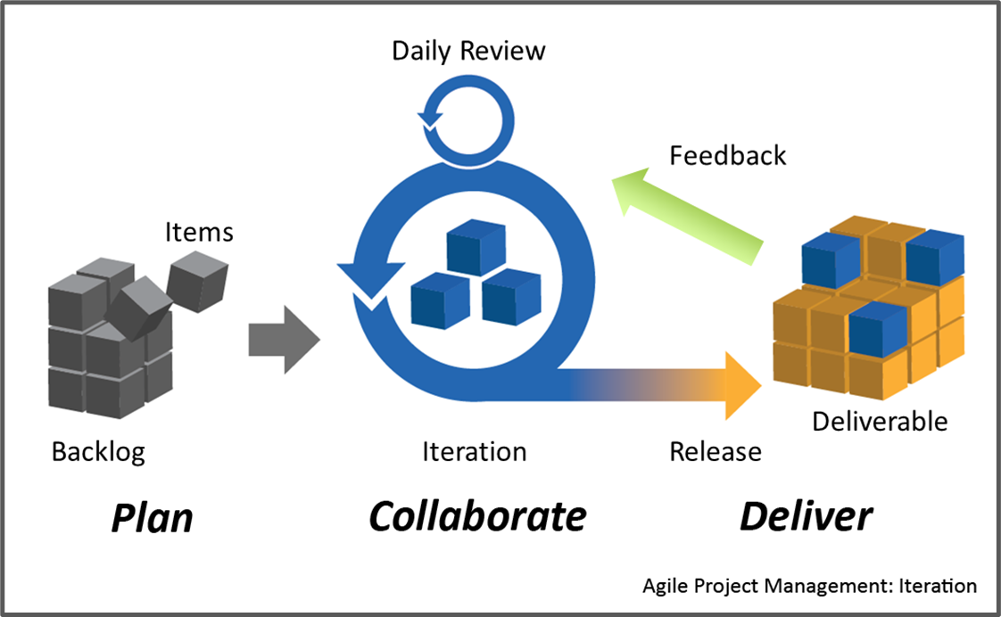
System Architecture

Slide 8
User stories
Sprint 1 - Basic Setup, Research and Analysis
Sprint 2 - Daily CO₂ footprints Input
Sprint 3 - Reports and Analytics with Data Visualization
Sprint 4 – Testing, Documentation, Knowledge Transfers, Advanced Features

Slide 9
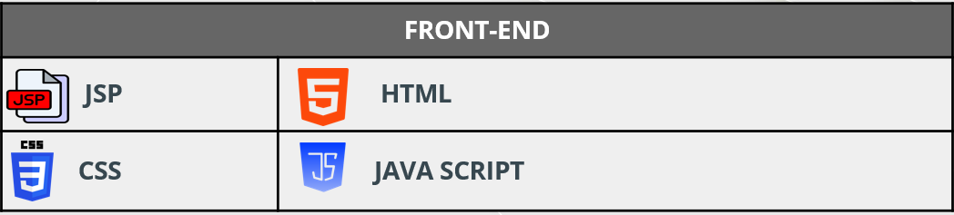
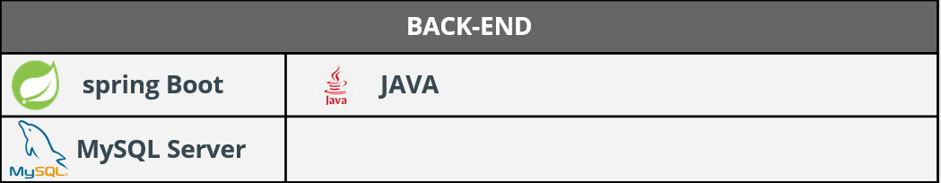
Tools And Technology

Slide 10
Springboot RestfulAPI
  Facilitate seamless communication between frontend and backend.
  Scalable, secure, and standardized data exchange.

Slide 11
MVC Architecture
  Model-View-Controller is a software design pattern for separating concerns in application development.
  Model :
  - Represents data and business logic.
  - Interacts with the database.
  View :
  - Displays data to the user.
  - Interacts with the controller for updates.
  Controller :
  - Handles user input and orchestrates communication between Model and View.

Slide 12
UML Diagrams
  ER-Diagram
  Use Case Diagram
  Activity diagram

Slide 13
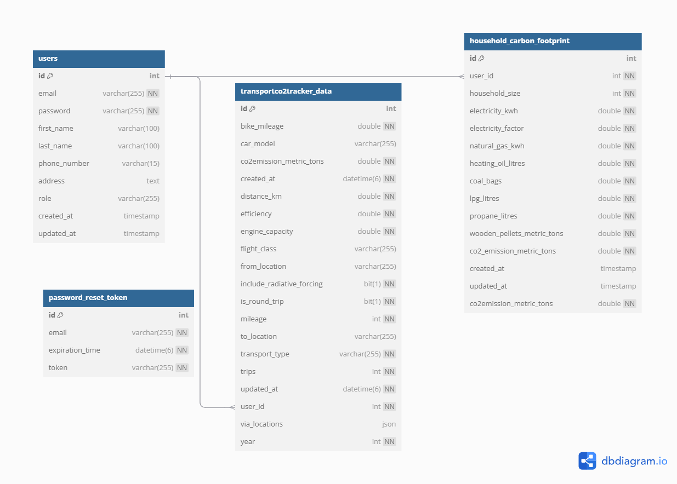
Diagrams
ER Diagram

Slide 14
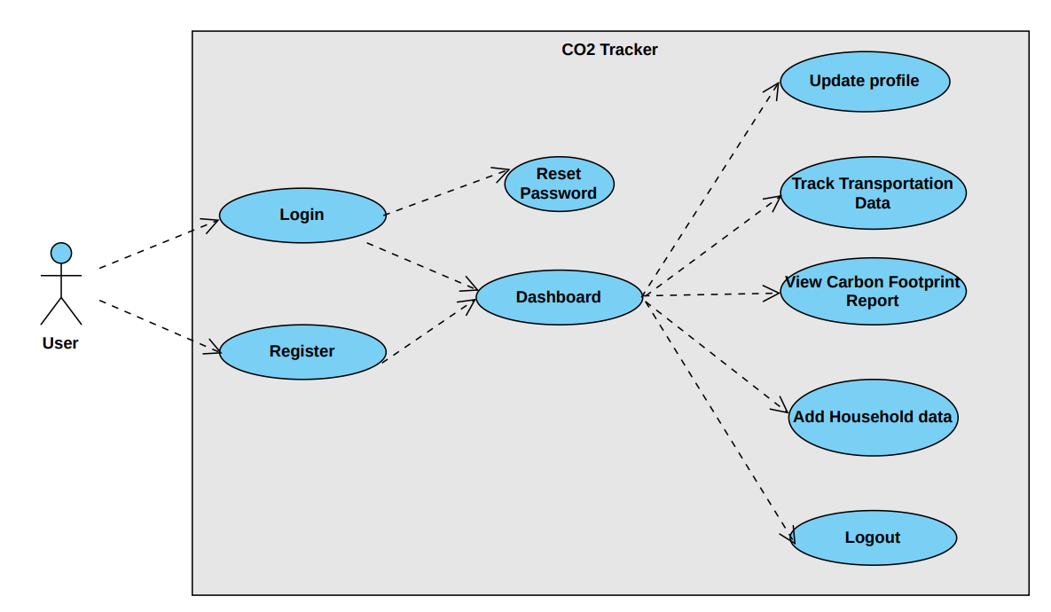
Diagram
Use Case Diagram

Slide 15
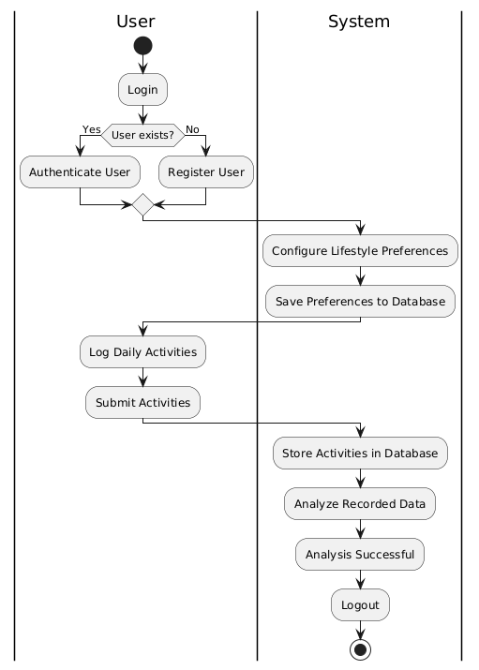
Diagrams
Activity Diagram

Slide 16
Demonstration

Slide 17
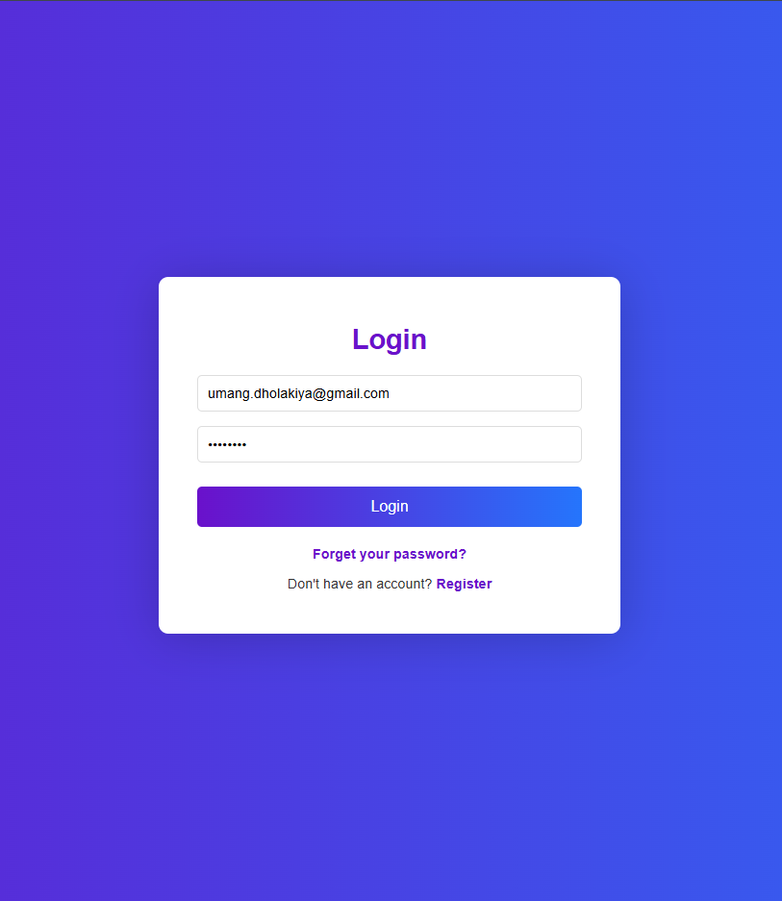
Demo – Login and registration
The user authentication procedure, which consists of two crucial processes, ensures secure systems access:
Login
Existing users authenticate themselves by entering their username and password.

Slide 18
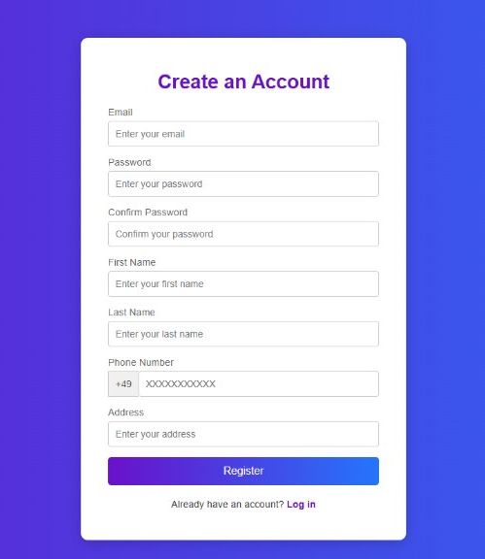
Demo – Login and registration
Sign-Up
New users create an account by providing essential details: Email, password, and confirming the password, First name, Last name, contact details etc.
Users can enter their credentials to log in after successfully registering.

Slide 19
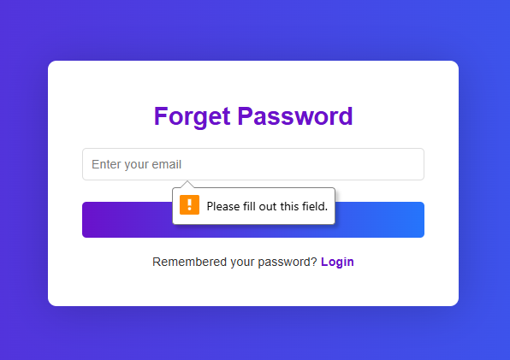
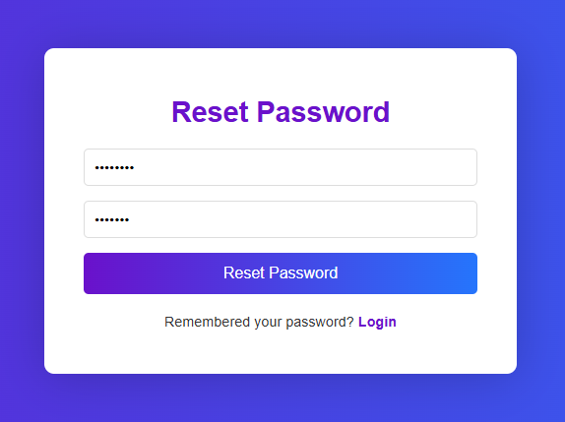
Demo – Forget And Reset Password
Forget Password
Forgot Password option allows users to recover their credentials if needed.
Reset Password
Enable users to securely reset their password through a verification process.

Slide 20
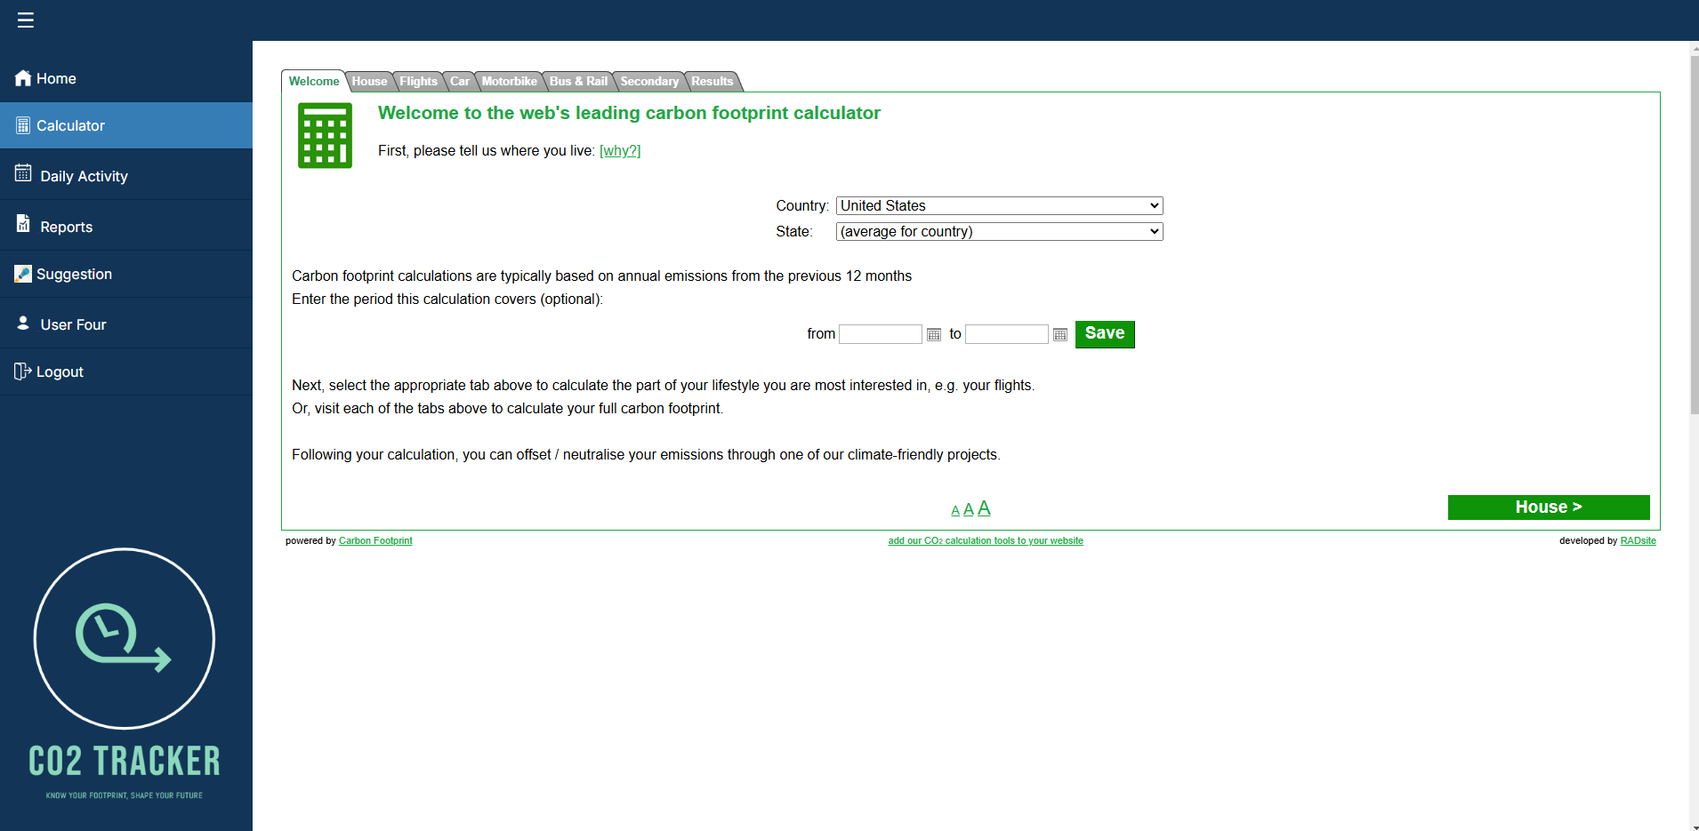
Demo – User Dashboard
  Carbon Footprint Calculator Interface
  The interface of a carbon footprint calculator website. The main purpose of this tool is to help users calculate their CO₂ footprints based on different aspects of their lifestyle.
  This interface highlights an organized and user-friendly design, making it easier for individuals to understand and manage their carbon footprints.

Slide 21
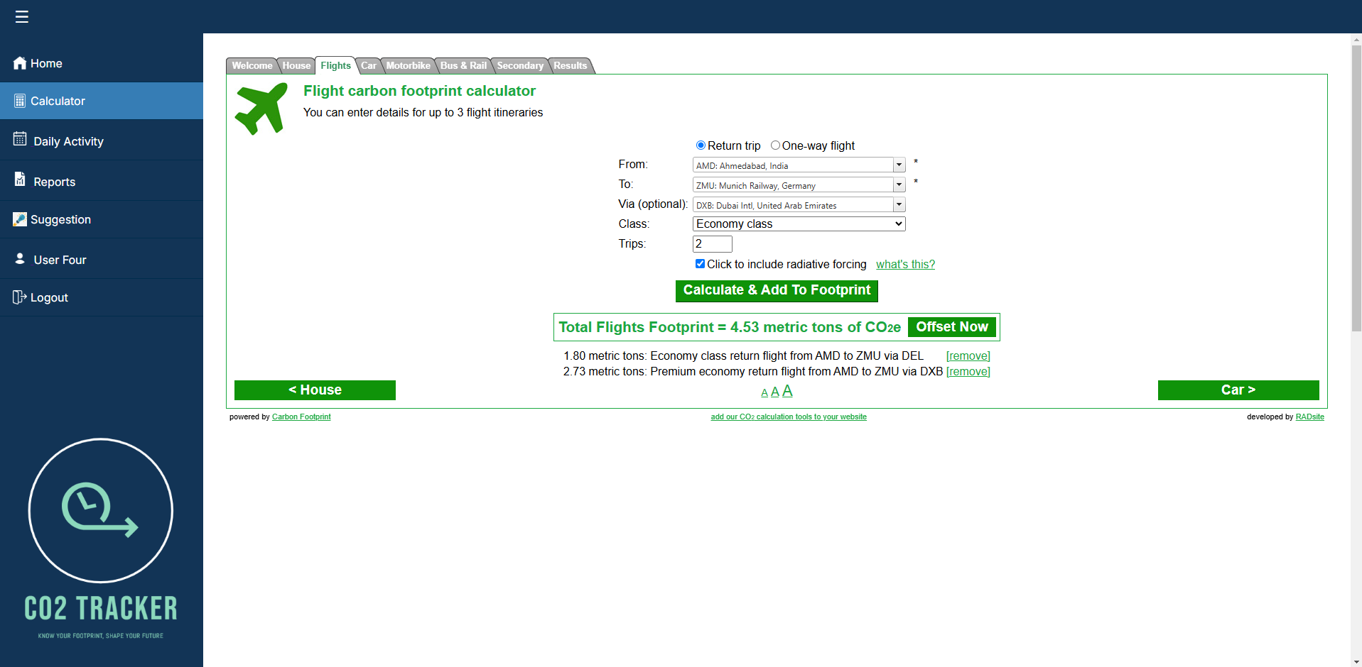
Demo – User Dashboard​
Flight Carbon Footprint Calculator Interface
- Users can specify flight itineraries, including departure and arrival locations, optional layovers, and flight class (e.g., economy or premium economy).
- It supports multiple trips and allows users to specify whether it’s a return trip or one-way flight.
- Third party open-source calculator for calculation purpose
Reference: https://www.carbonfootprint.com/calculator.aspx

Slide 22
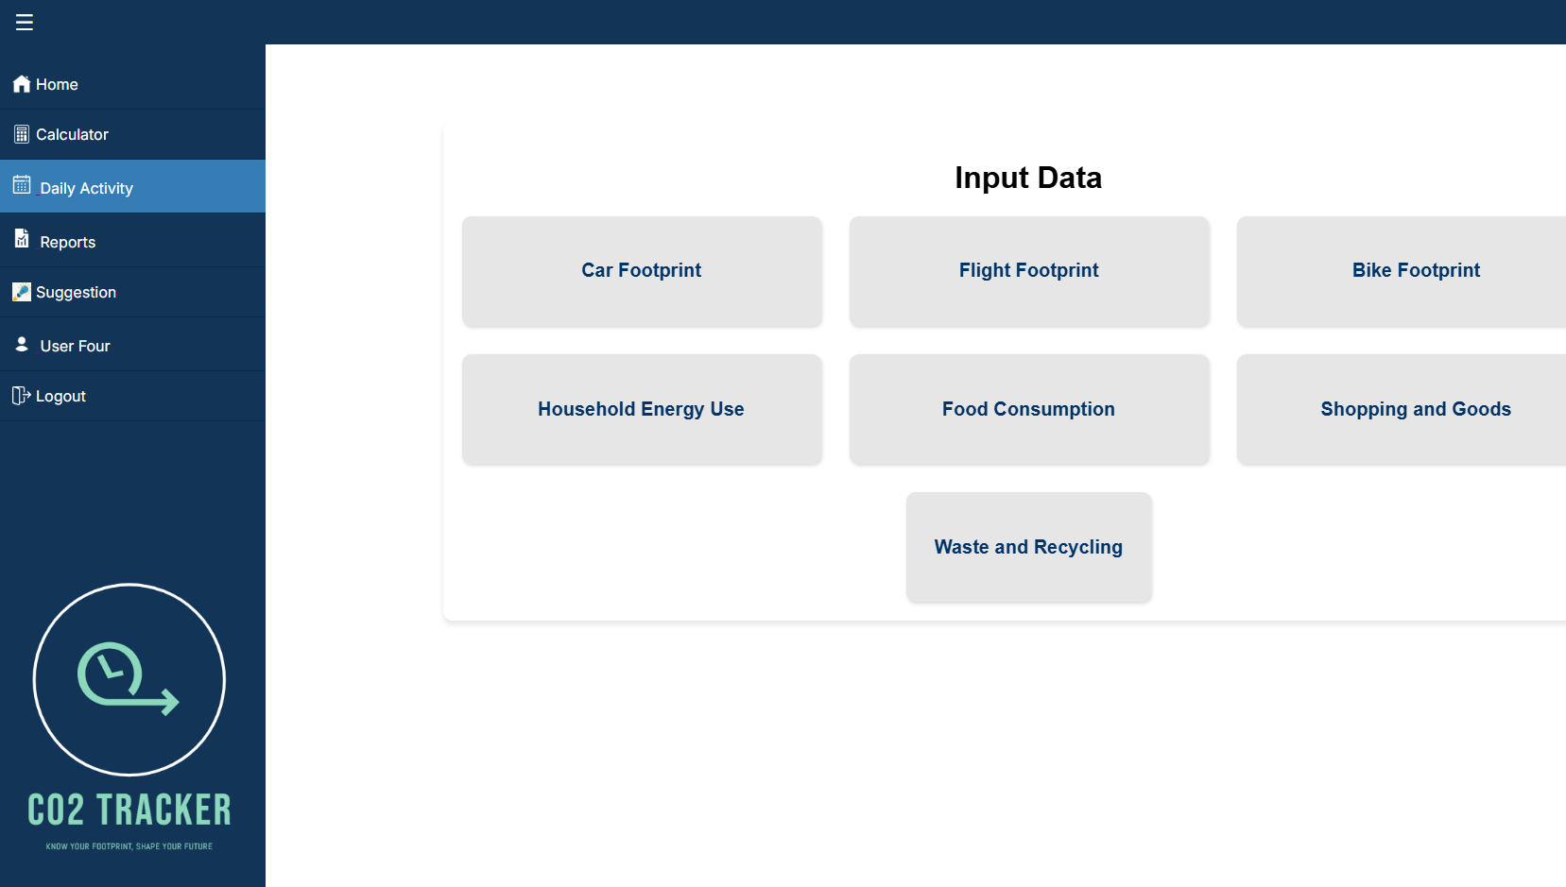
Demo – Daily Activity
Input Data
Simplifies data entry for users to calculate their overall carbon footprint efficiently.
  Acts as a centralized interface for personalized carbon tracking.
  Displays key categories for carbon footprint inputs: Car, Flight, Bike Footprint, Household Energy Use, Food Consumption, Shopping and Goods, and Waste and Recycling.

Slide 23
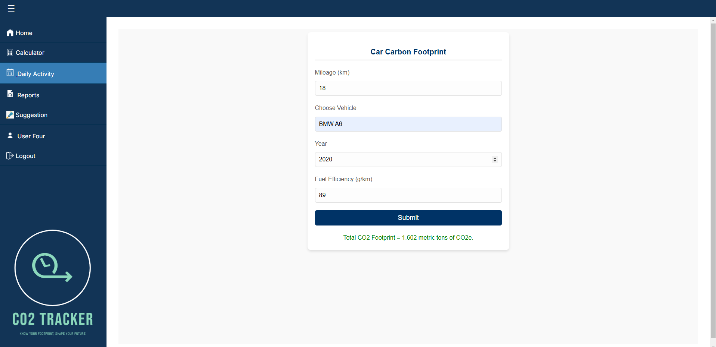
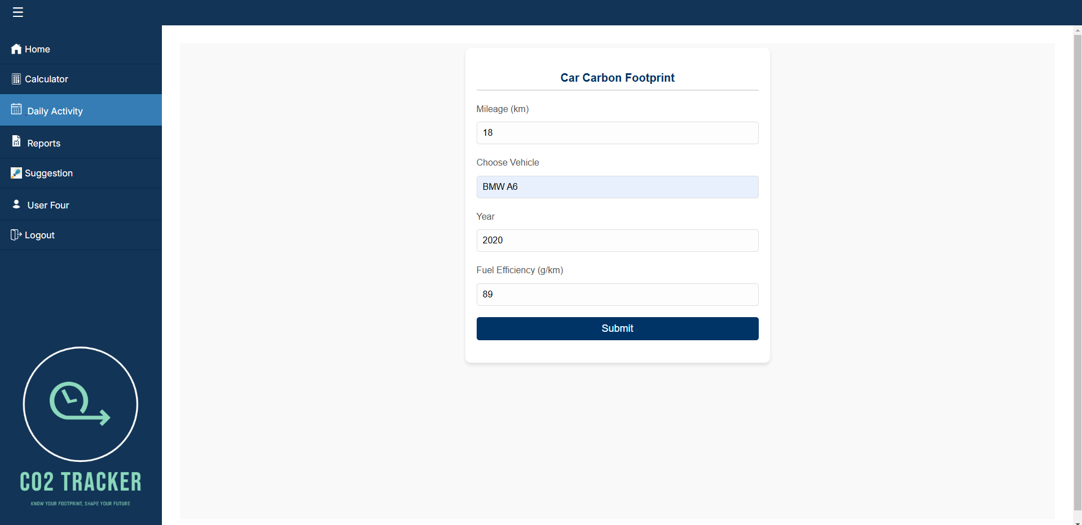
Demo – Daily Activity
Car Carbon Footprint
  Users were unaware of the environmental impact of their daily car usage, including mileage, vehicle efficiency, and footprints.
  Users can calculate their car's carbon footprint by entering data such as mileage, vehicle type, year, and fuel efficiency.

Slide 24
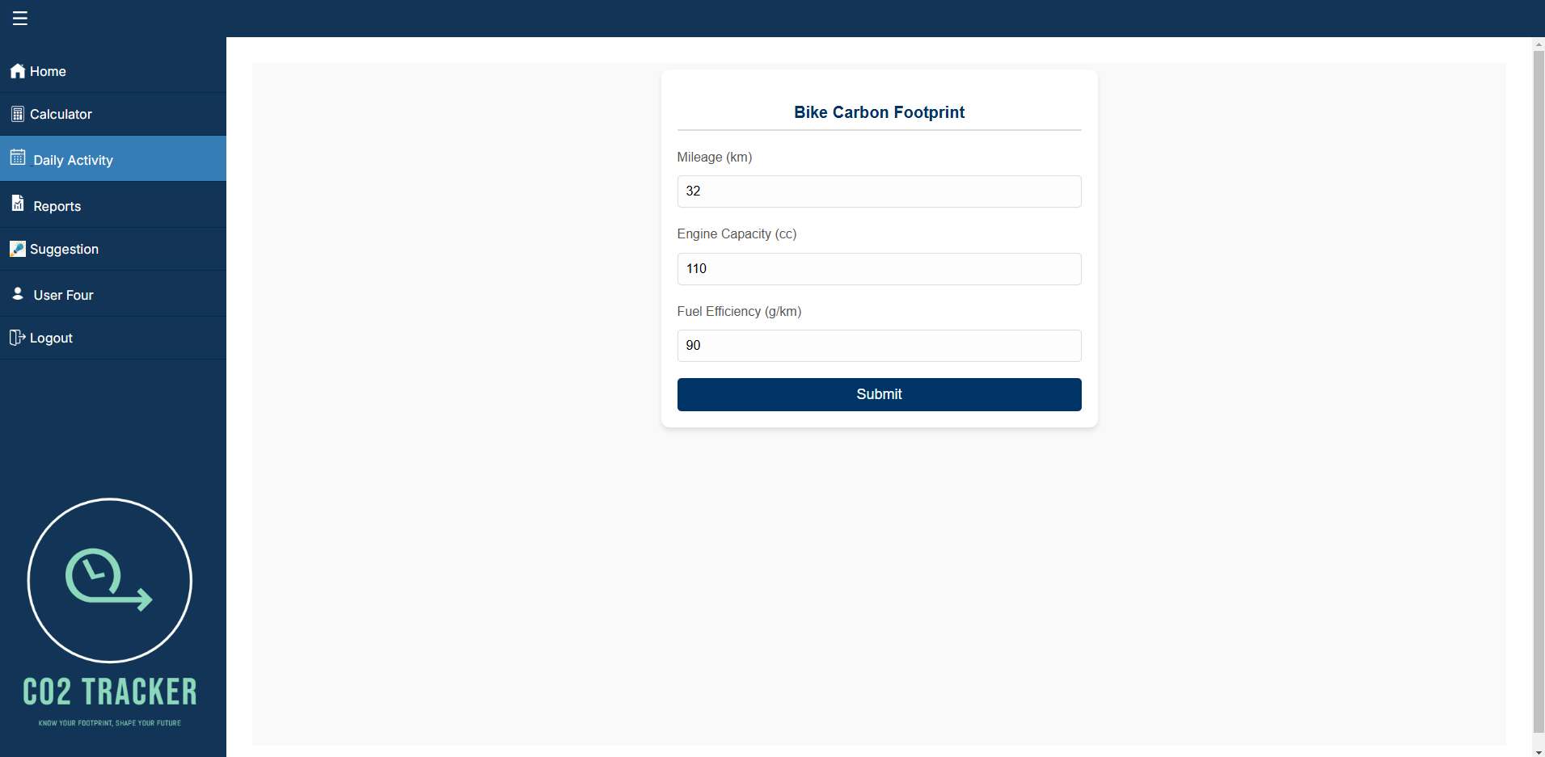
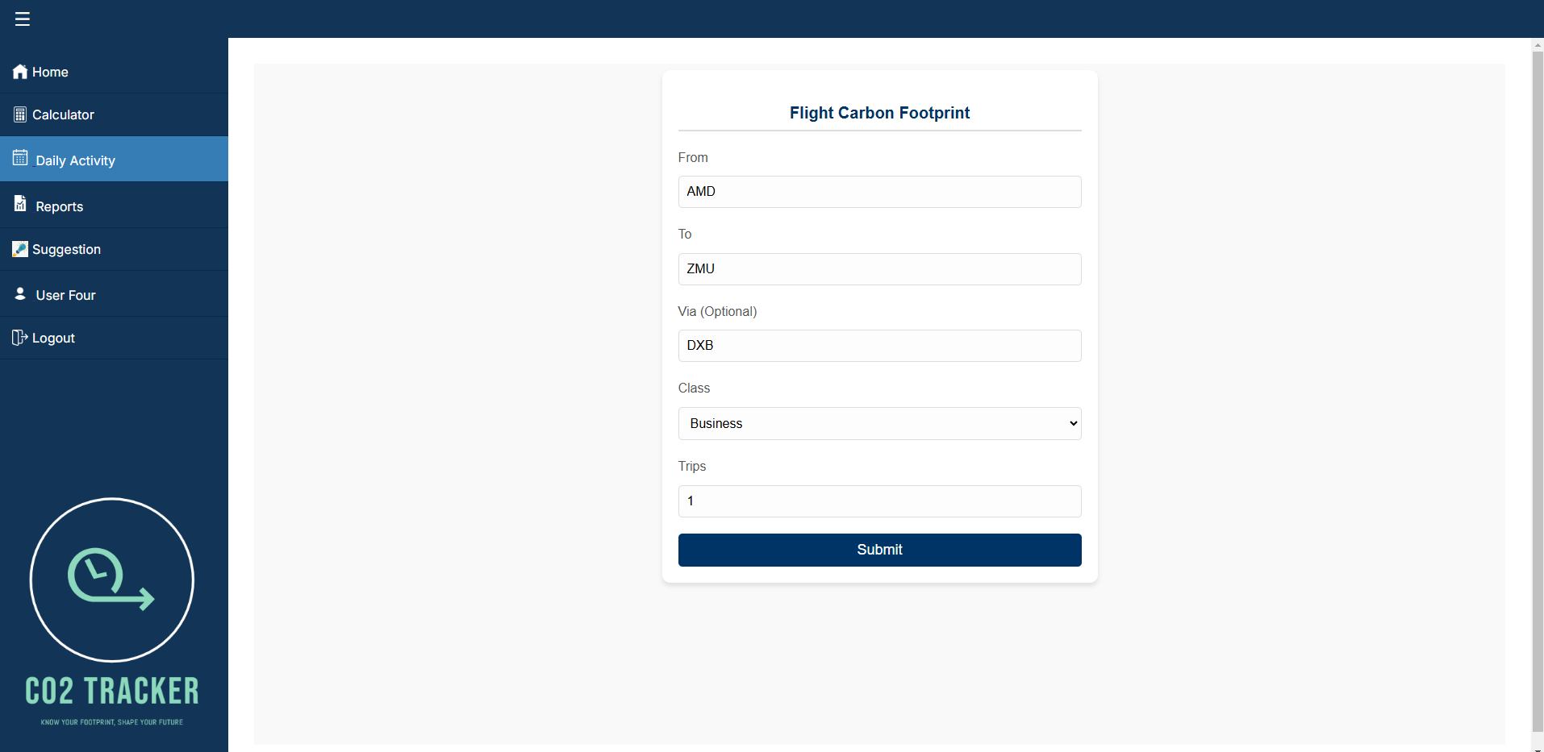
Demo – Daily Activity
Flight And Bike Carbon Footprint
For Bike Carbon Footprint
  users to calculate the carbon footprints from bike usage based on mileage, engine capacity, and fuel efficiency.
  User friendly interface for submitting data and estimating footprints..
For Flight Carbon Footprint
User can estimate carbon footprints for air travel by considering travel routes, class type, and the number of trips.
Users can submit the information to receive an estimate of their environmental impact.

Slide 25
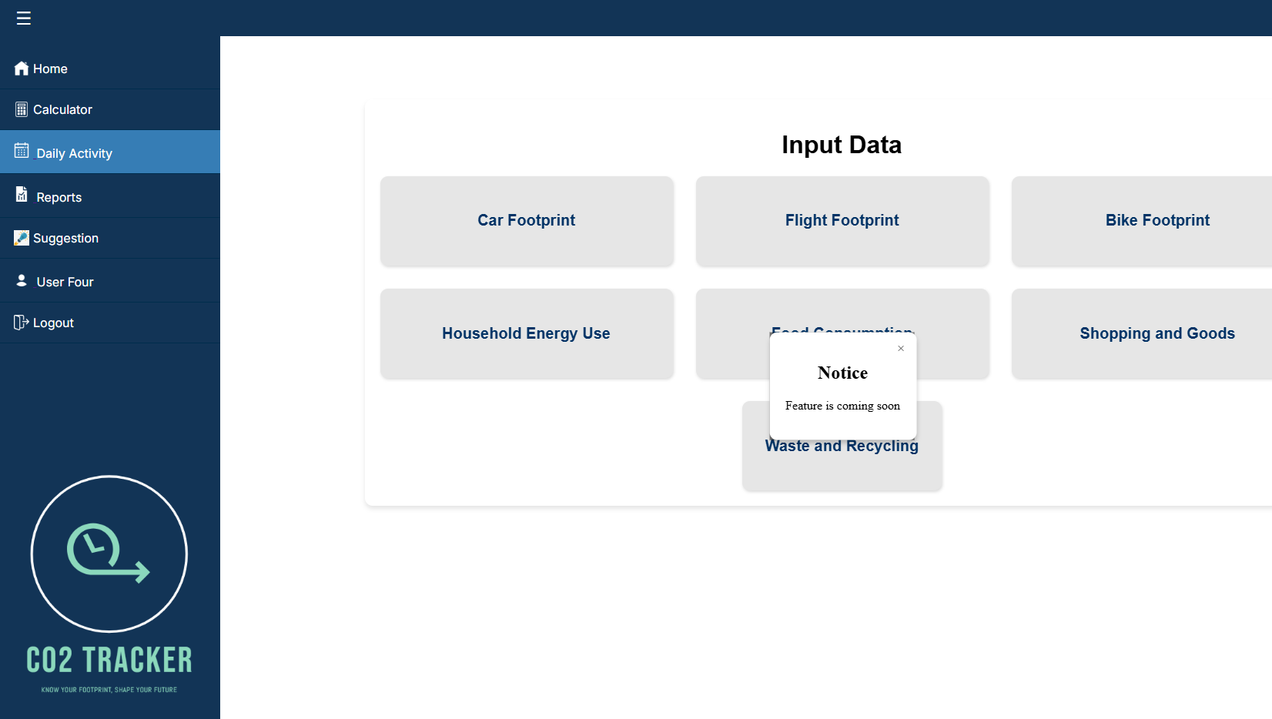
Demo – Daily Activity
Yet to Release Footprint

Slide 26
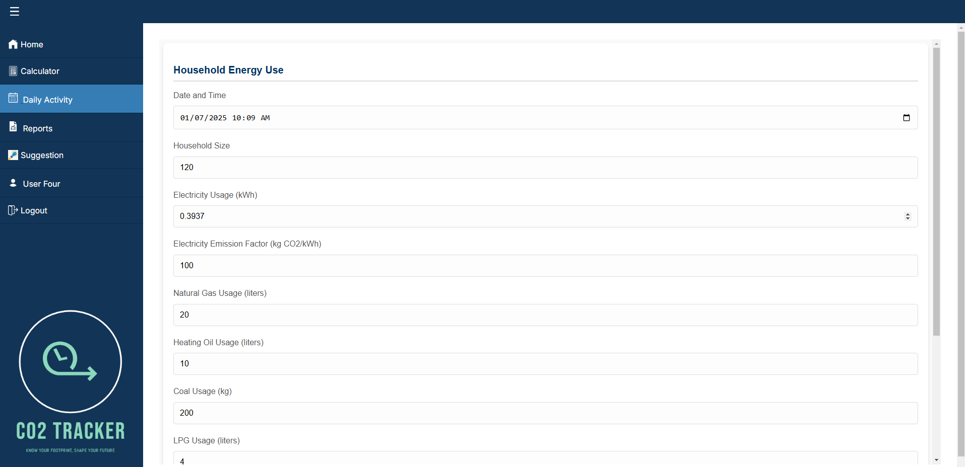
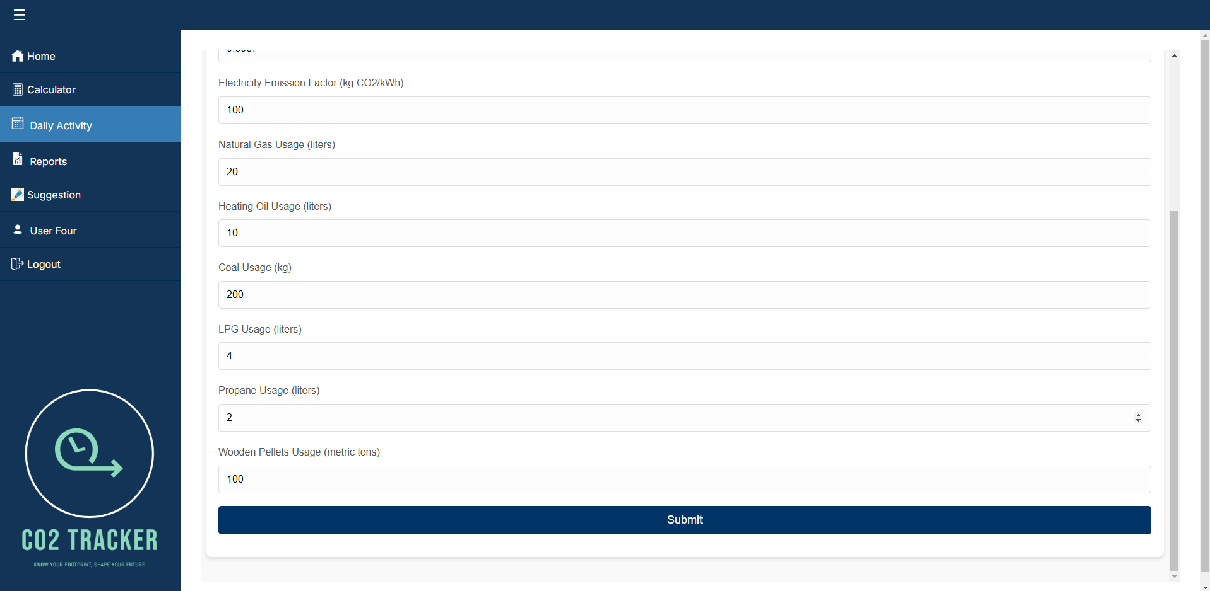
Demo – Household Energy

Slide 27
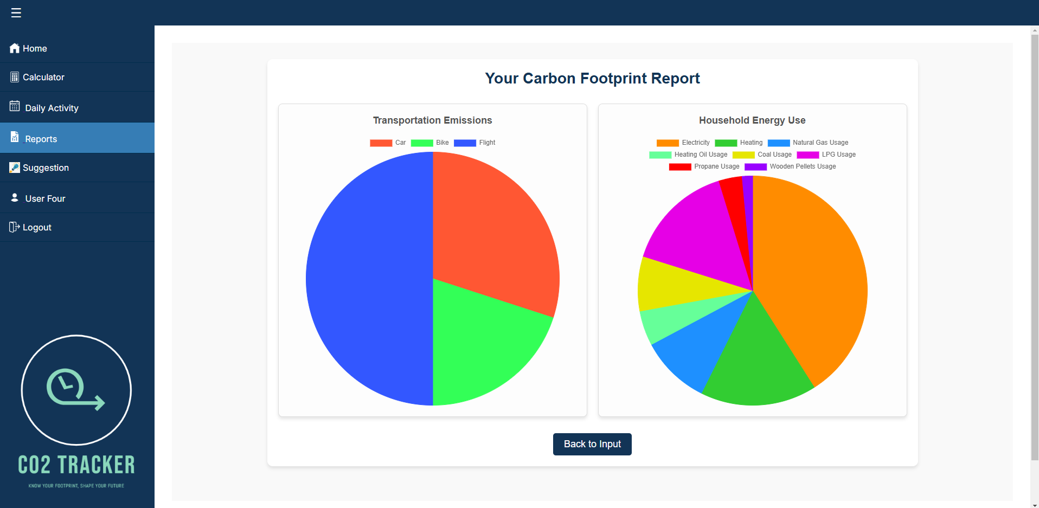
Demo – Analysis Dashboard
Purpose: Visualizes transportation and household energy footprints.
Transportation Insights: Flights contribute the most, followed by cars and bikes.
Household Insights: Electricity usage dominates, with natural gas and heating as significant contributors.

Slide 28
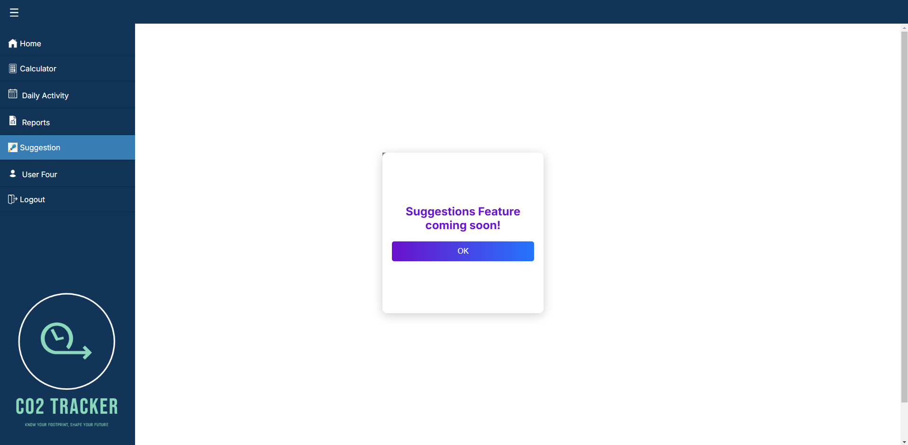
Demo – Suggestion Feature
  A smart suggestion feature to provide personalized recommendations to streamline the experience.

Slide 29
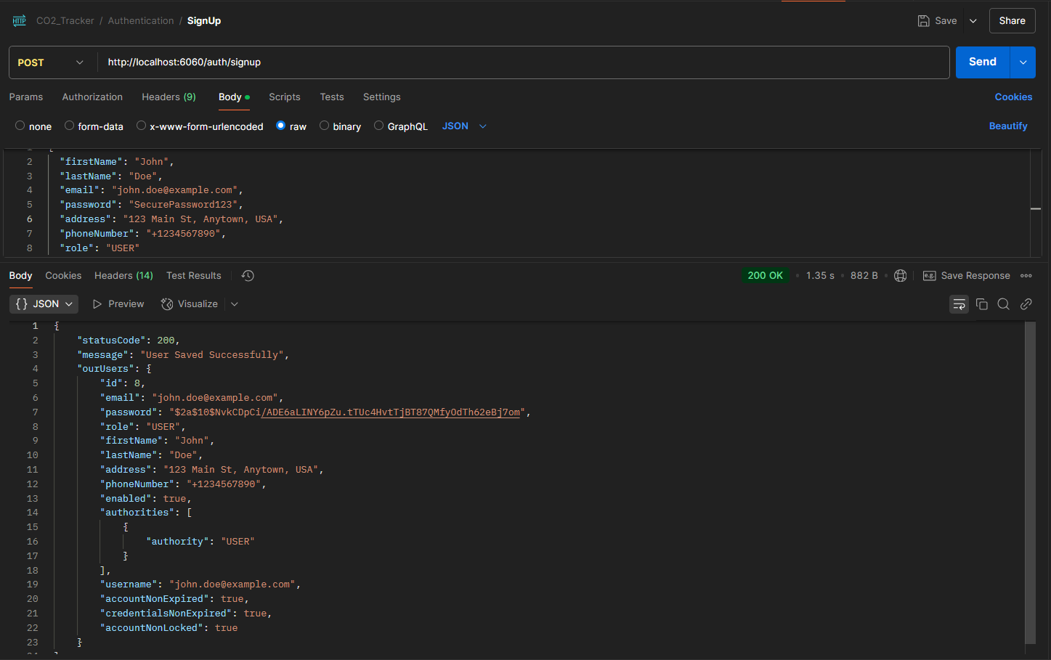
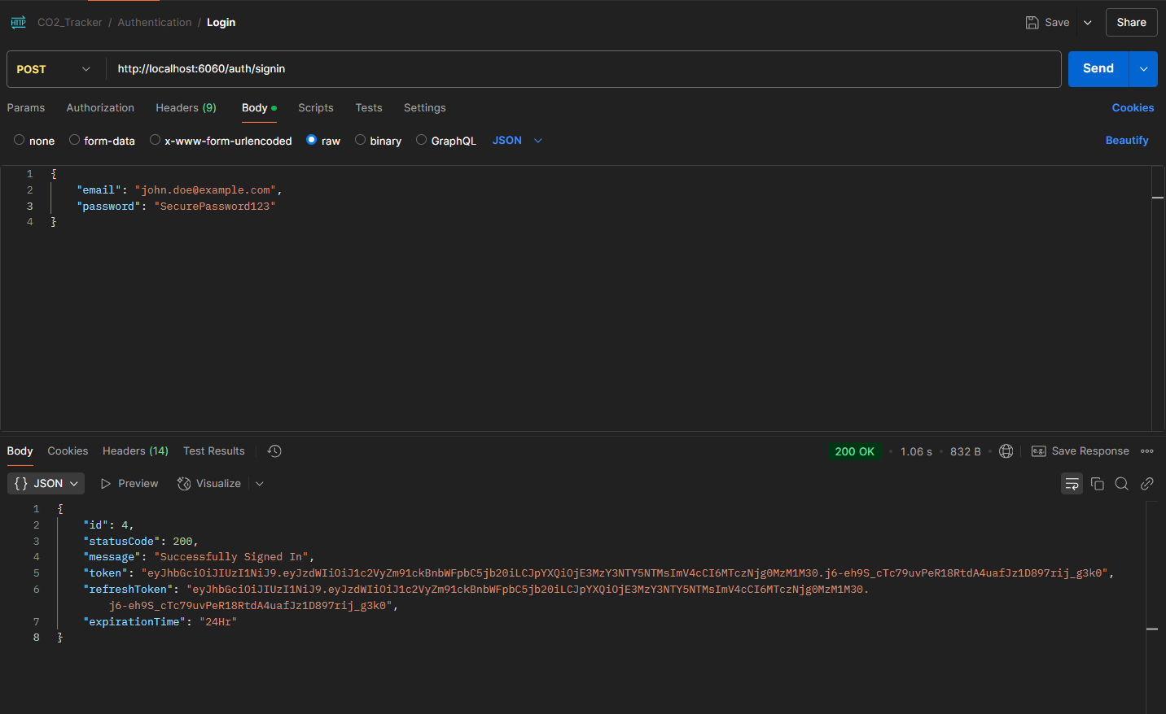
JWT Token Authentication
  JSON Web Token (JWT) is a secure, compact, and self-contained method for transmitting user authentication data between a client and server.
  Ensures secure access to protected resources by verifying the token's validity using a secret key or public/private key pair.

Slide 30
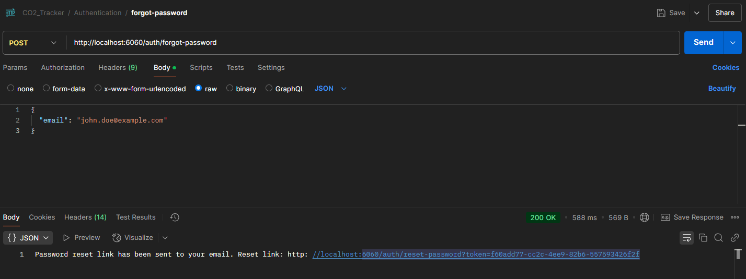
Forgot Password
  Screenshot of Reset Password Token being sent to the user's mail

Slide 31
Testing And Result
White Box Testing - Scope: Individual class functions and constructors. - Responsibility: Developers test and debug their own Code. - Approach: Verify each method's functionality. | Black Box Testing - Scope: Integrated system after all components are assembled. - Focus: Validate Tracker application under all possible usage scenarios. - Comprehensive coverage of user interactions and workflows.

Slide 32
Future Enhancements
Educational Resources
Gamification Elements
Custom Reports
Peer Comparison
API for Data Import/Export -
  Enable integration with fitness apps, GPS devices etc.

Slide 33
Challenges
Synchronization issues with the database.
Integrating APIs for data like local electricity grids, transport footprints.

Slide 34
Highlights
Monitor, analyse, and optimize daily activities for a sustainable lifestyle
Track CO2 footprints in mobility, eating habits, and consumer behaviour
Gain insights into carbon footprint
Awareness: Understand daily CO2 footprints
Personalized Insights: Tailored recommendations
Data Visualization: Clear charts and reports
Continuous Improvement: Make iterative improvements.

Slide 35

Vielen Dank!
Ostbayerische
Technische Hochschule (OTH) Amberg-Weiden
Kaiser-Wilhelm-Ring 23 | 92224 Amberg

